Slide 2

Finding Valuable Needles in Global Source Code Haystacks
With Automation!

Slide 3

Thank you and congrats!

Slide 4
Agenda
whoami?
What Do I Want and How Do I Get It?
Where Can I Get What I Want?
Where’s my Merciless Automation?
Any Results?
So What Do I Do?
What’s Next?
Questions?

Slide 5
whoami?
LAGORIO\Jay (jay@lagor.io)
B.S. Computer Science, UMBC (2008)
M. Eng. Electrical Engineering, NPS (2015)
CISSP, various SANS certifications over the years
Developer, IT Consultant, Private Investigator
Projects at UMBC as a student, many projects thereafter
Maryland-based Ambulance company
Other sectors, and myself

Slide 6
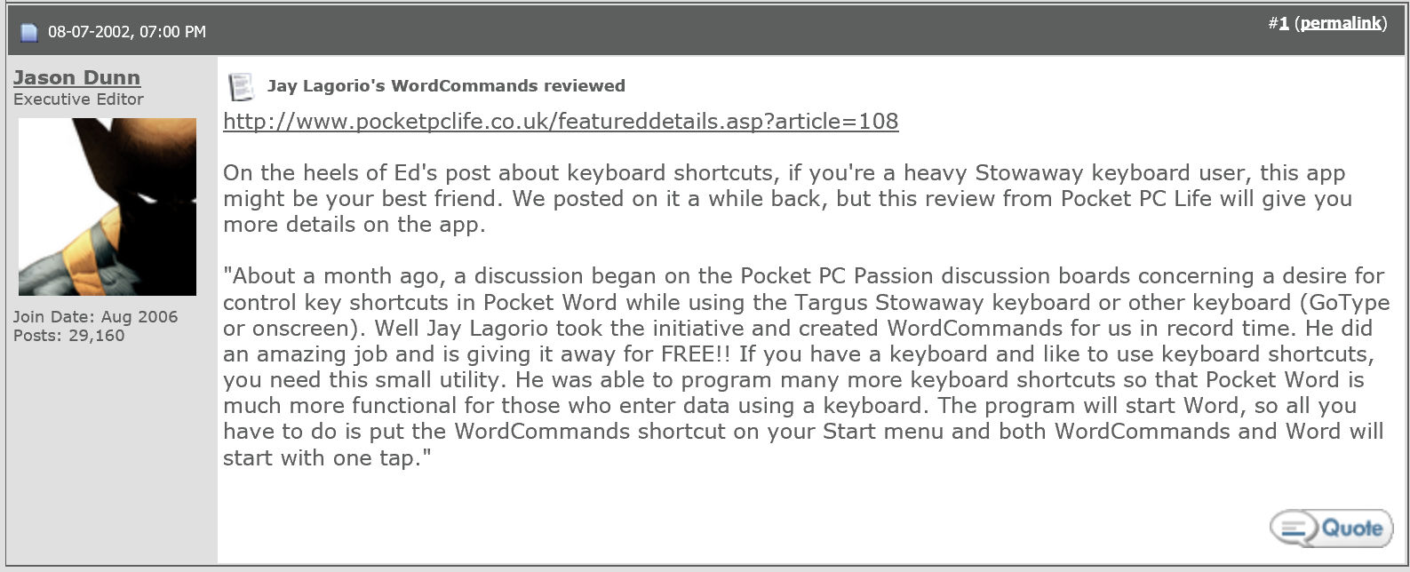
whoami?
Win32 C Developer, Windows enthusiast
WordCommands for Pocket PC

Slide 7
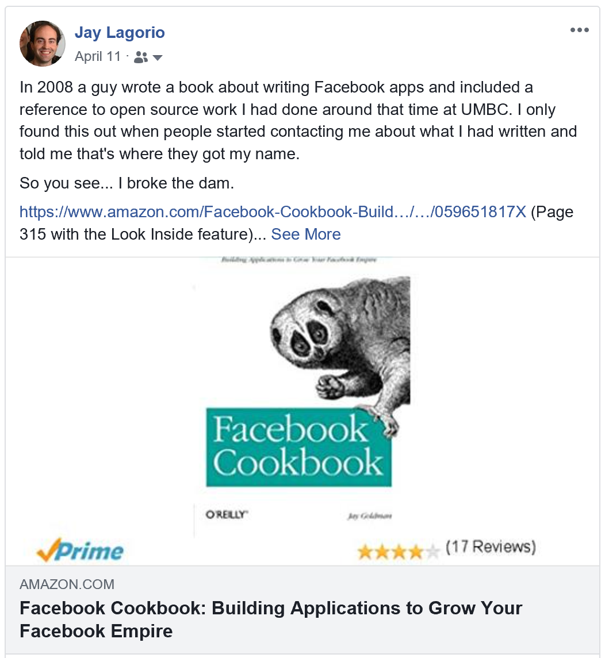
whoami?
.NET Developer
Facebook API 1.0 library
Workflow management (PHP too!)
The tool we discuss today

Slide 8
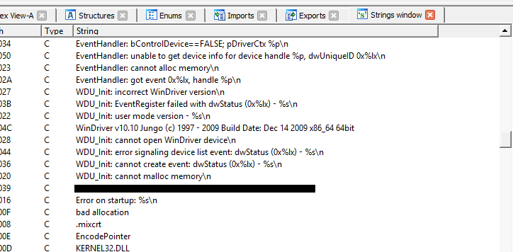
whoami?
Software RE
Medical stuff: reverse engineered a proprietary driver so the device could be used in Windows Store apps (Nightscout Foundation: #WeAreNotWaiting)
Generally Curious but Law-Abiding Trouble Maker

Slide 9
Agenda
whoami?
What Do I Want and How Do I Get It?
Where Can I Get What I Want?
Where’s my Merciless Automation?
Any Results?
So What Do I Do?
What’s Next?
Questions?

Slide 10
What Do I Want and How Do I Get It?
As an OSINTer, I want to find “cool stuff” on the Internet that probably shouldn’t be on the Internet…
…and then I want to engage in responsible disclosure.
What’s “cool stuff?”
Private keys and cryptographic material
API keys and secrets
Configuration files that might contain credentials
Open Buckets with sensitive data
*My* private data unexpectedly on the Internet
Notes:
Today I stand in front of you an OSINTer, so…

Slide 11
What Do I Want and How Do I Get It?
Trolling for random exposed data is labor intensive
But you get the best pay off:
An umpteen million credentials, found in countless Pastes
Verizon Wireless, 2017, Kromtech Security Center found a Bucket
FedEx, 2018, Kromtech Security Center found a Bucket
Capital One, 2018, UpGuard found a Bucket
GoDaddy, 2018, UpGuard found a Bucket
Pocket iNet, 2018, UpGuard found a Bucket
North Carolina Board of Elections, 2018, Chris Vickery (@VickerySec) found a Bucket
The Pastes are many, varied, and infinite, but Buckets being bigger you get tons of bang for your buck
Notes:
https://www.hackread.com/unprotected-aws-bucket-exposes-50-gb-of-financial-giants-data/
https://www.securityweek.com/amazon-s3-bucket-exposed-godaddy-server-information
https://securityboulevard.com/2018/02/identity-documents-exposed-in-fedex-owned-amazon-s3-bucket/
https://threatpost.com/leaky-amazon-s3-bucket-exposes-personal-data-of-12000-social-media-influencers/129810/
https://threatpost.com/verizon-wireless-internal-credentials-infrastructure-details-exposed-in-amazon-s3-bucket/128108/

Slide 12
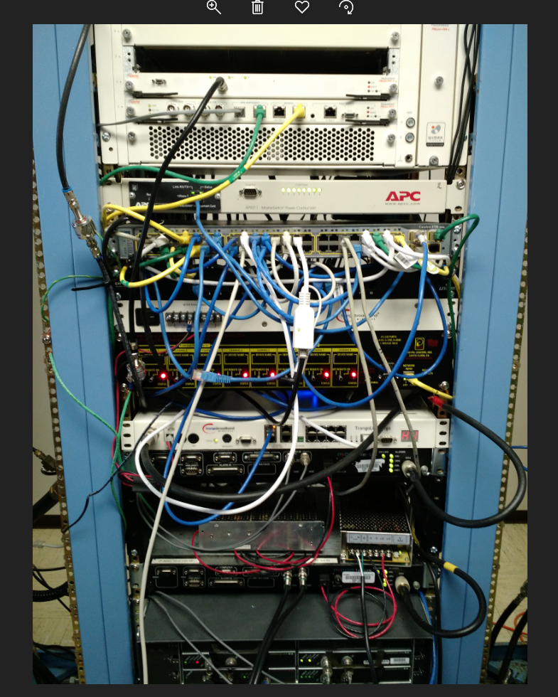

Slide 13
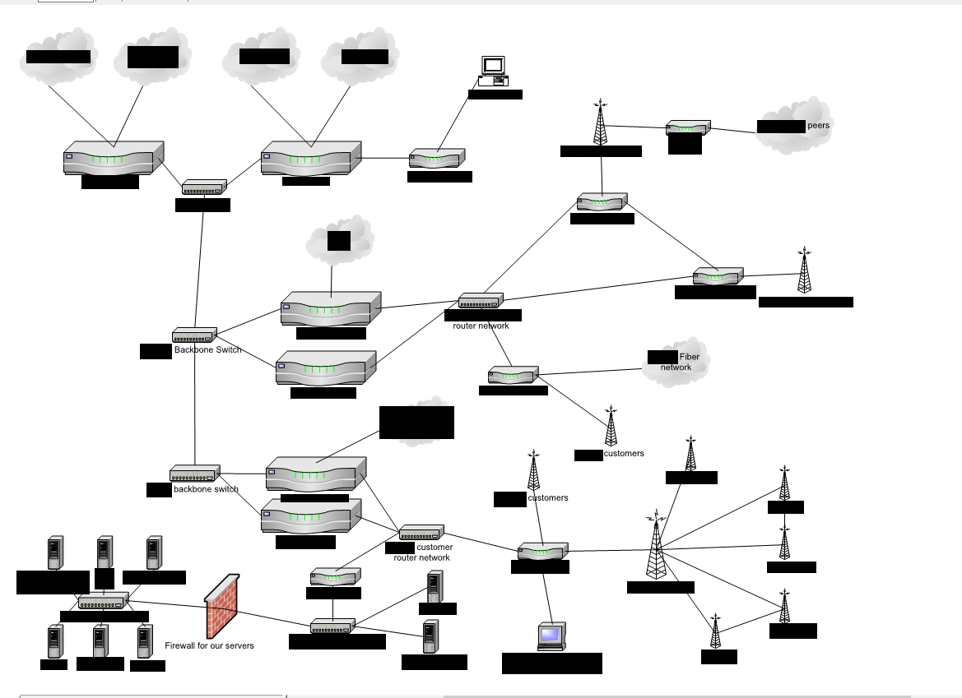

Slide 14
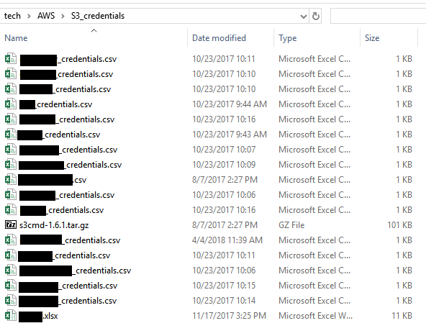

Slide 15
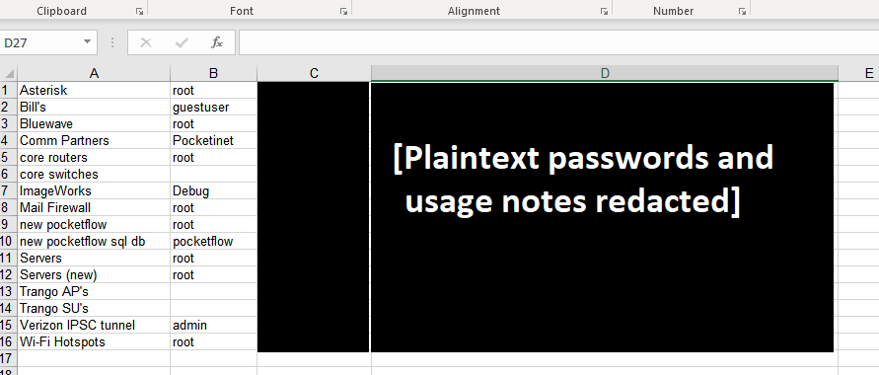

Slide 16
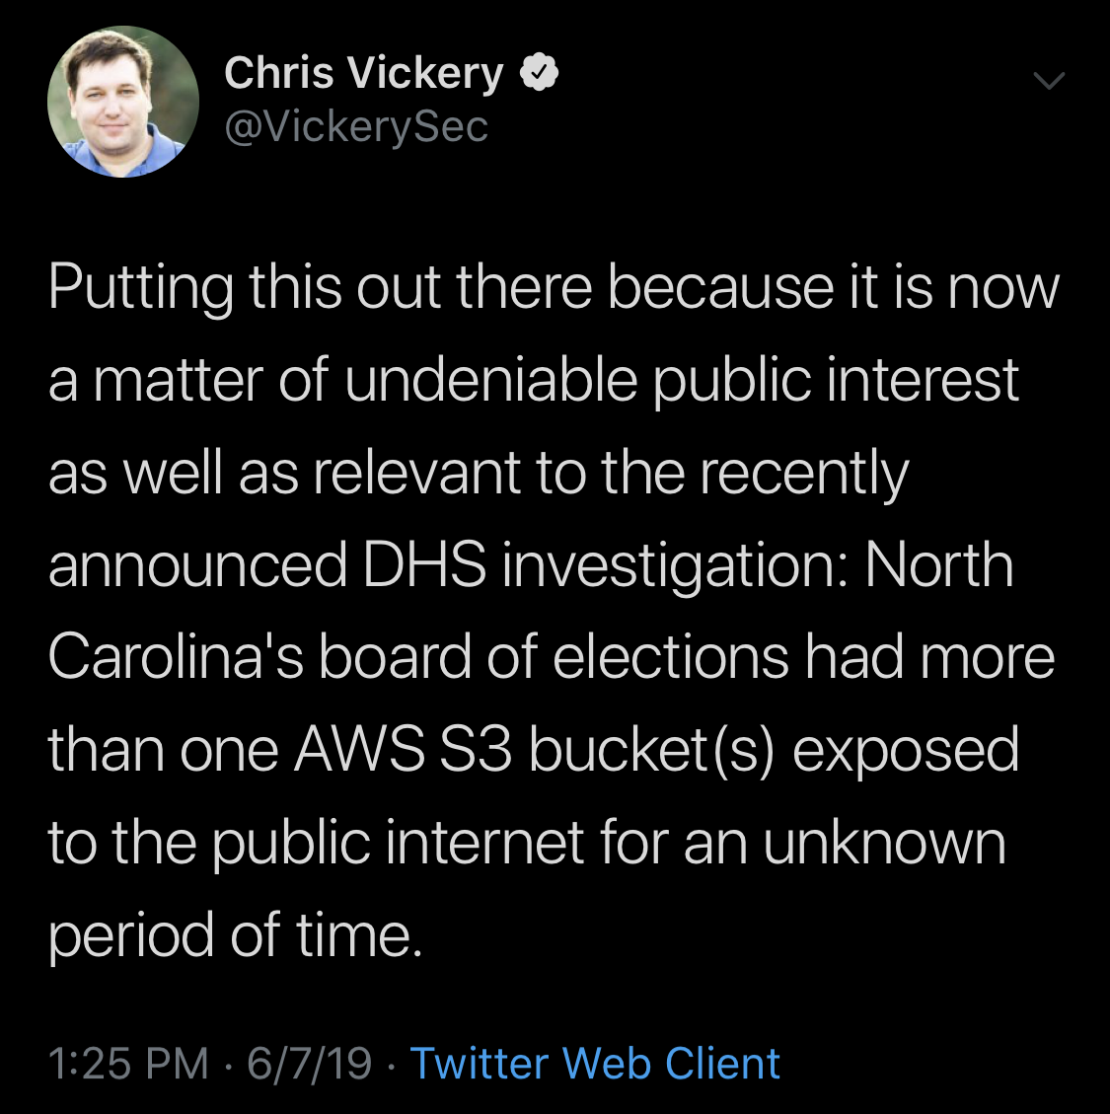

Slide 17
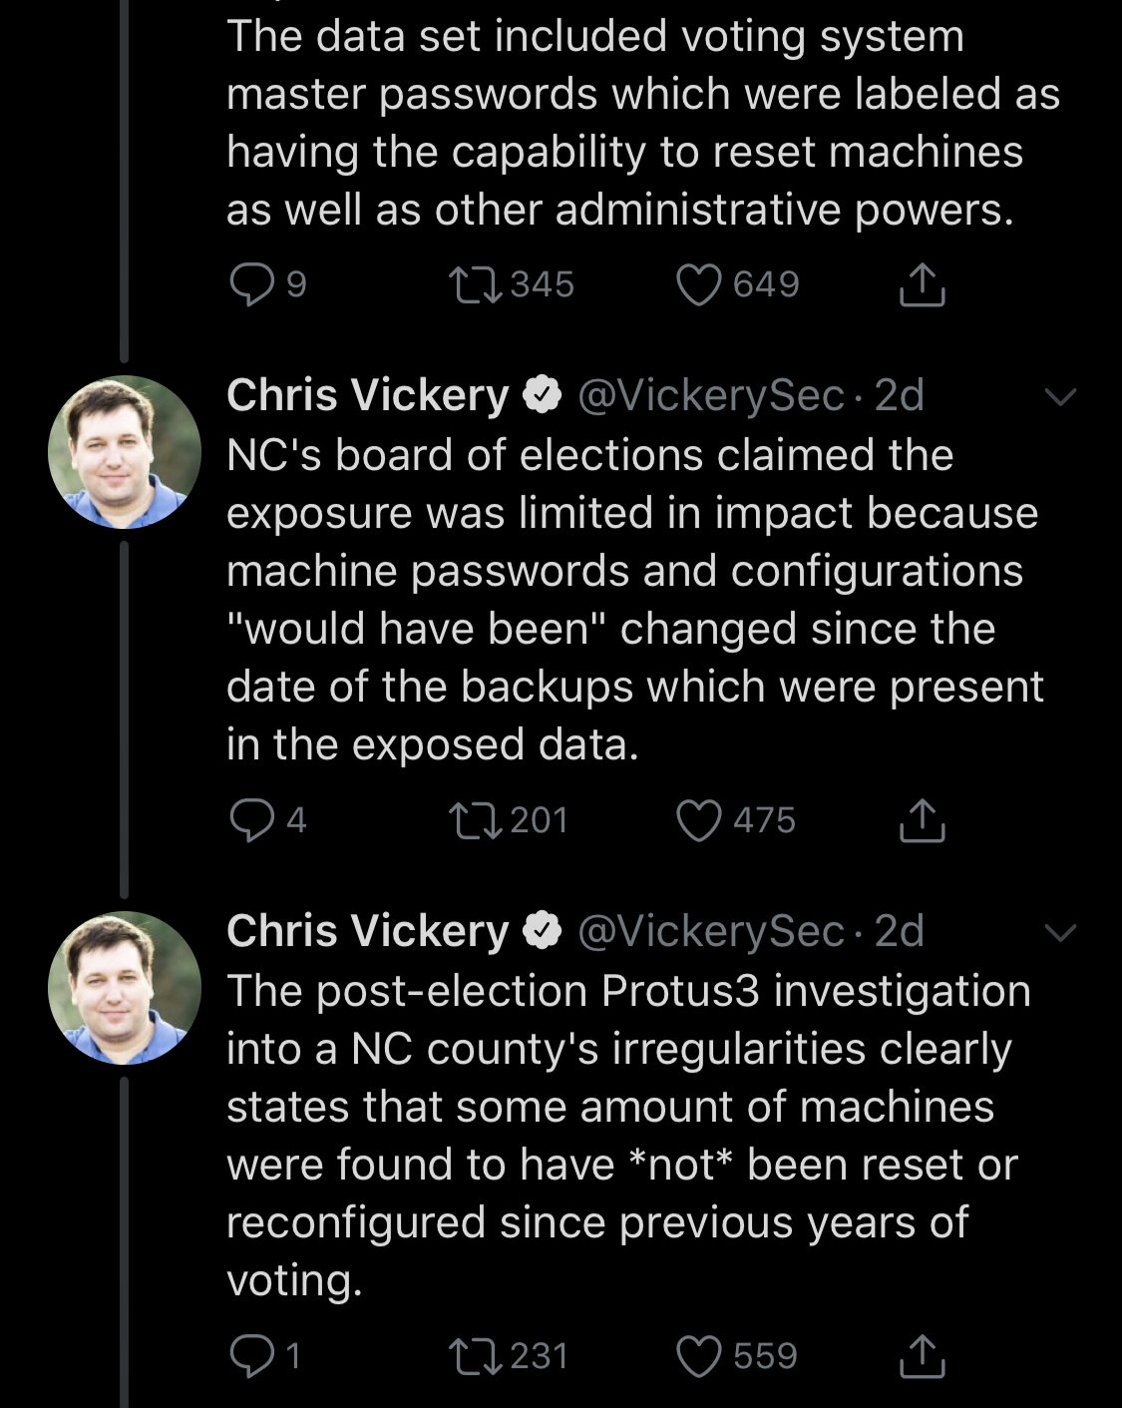

Slide 18
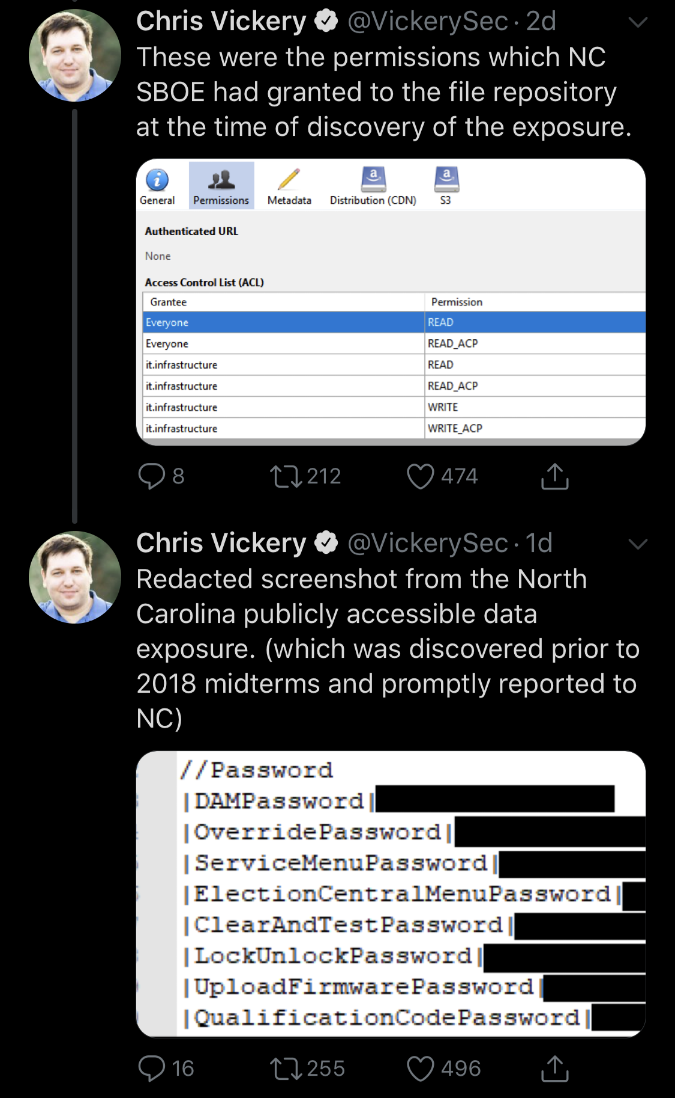

Slide 19

What Do I Want and How Do I Get It?
Notes:
Buckets are everywhere, they’re the scourge of the earth, and it’s our job to find them.

Slide 20
What Do I Want and How Do I Get It?
That’s general data searching, but even targeted Red Teaming for bug bounties is labor intensive
Subdomain searching
Repo scraping
API endpoint discovery
Confidential or configuration data discovery (key material, etc)
You can do this manually using tailored lists of keywords
Again, though:

Slide 21

How Does This Help Me?

Slide 22
What Do I Want and How Do I Get It?
Computers should be doing things I don’t want to do because I’m lazy.
I don’t want to manually search for cool stuff, I want it brought to me because I’m lazy.
I need Merciless Automation.
Because I’m lazy.
I’d like a frontend so I can go through what the automation found.
Even if the frontend sucks, it’s better than nothing.

Slide 23
Agenda
whoami?
What Do I Want and How Do I Get It?
Where Can I Get What I Want?
Where’s my Merciless Automation?
Any Results?
So What Do I Do?
What’s Next?
Questions?

Slide 24
Where Can I Get What I Want?
Pastebin (https://pastebin.com/)
Developers post Pastes containing source code and they’re World Readable unless extra steps are taken (they often aren’t).
Presumably they do this because they don’t have a good collaboration tool?
Included in the source code: API Keys, salts, hard coded creds, etc.
Pulling this information in near real-time is as easy as hitting a REST endpoint.
Lifetime subscription: minimal cost for maximal data ($30 - $50 once, all of it).

Slide 25
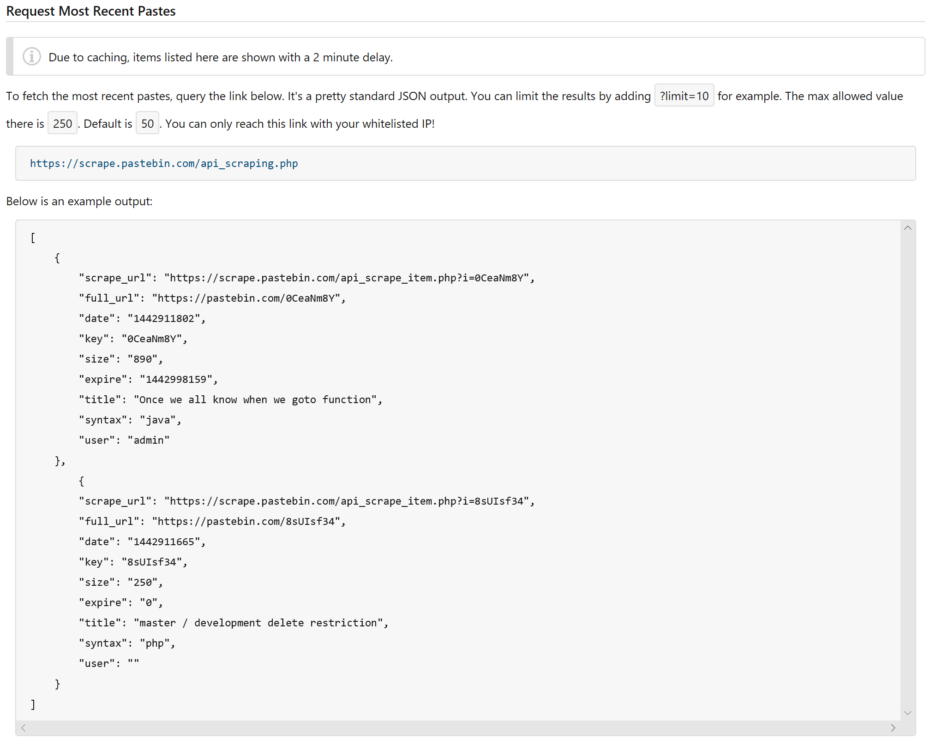
Where Can I Get What I Want?

Slide 26

Where Can I Get What I Want?
Github (https://github.com/)
The Social Media of source code repos
I’m a developer, I do stupid stuff and put it on the Internet all the time.
Surely other developers do stupid stuff and put it on the Internet too, right?
Plug keywords that correspond to things that shouldn’t be public on GitHub and use their public search API: API Keys, salts, hard coded creds, etc.
Doubles as a platform for responsible disclosure. We can let the developer know there’s a problem they should correct.

Slide 27
Where Can I Get What I Want?
Amazon S3 Buckets (https://aws.amazon.com/)
Buckets have giant treasure troves of data. All manner of useful stuff are in these Buckets just strewn around the Internet.
~20 regions and the Buckets can be in any, all, or just one
You can store any type of file, anything you want with near limitless file size.
Accessed via HTTP(S) and a domain name: thisismybucket.s3.amazonaws.com
Or by region: thisismybutcket.us-east-1.amazonaws.com
There is no master index, so how can you find these?

Slide 28
Where Can I Get What I Want?
Protoxin List (https://protoxin.net/s3/)
Security researcher in Virginia who collects Buckets to advance research on Amazon S3, adds to the list periodically.
Not all Buckets can be accessed publicly now, but you never know when permissions will change.
You can pull the list via REST API, check for new additions between now and the last time you pulled the list, and queue new buckets to check.
Currently has > 20,000 Buckets in the list.

Slide 29
Where Can I Get What I Want?
CertStream (https://certstream.calidog.io/)
Certificate Transparency Logs are generated whenever a certificate authority issues a certificate trusted by Firefox and Chrome.
CertStream is a real-time hook into the Certificate Transparency Logs so you can detect TLS certificate issuance as it happens.
Bucket domain names follow well-known patterns so we can hook the stream, watch for the pattern to detect new Buckets by seeing when owners get new TLS certificates, or detect existing Buckets when the certificates are renewed.
A simple JSON stream that comes in via Web Socket – nearly anything can consume it.

Slide 30

Where Can I Get What I Want?
CertStream (https://certstream.calidog.io/)

Slide 31
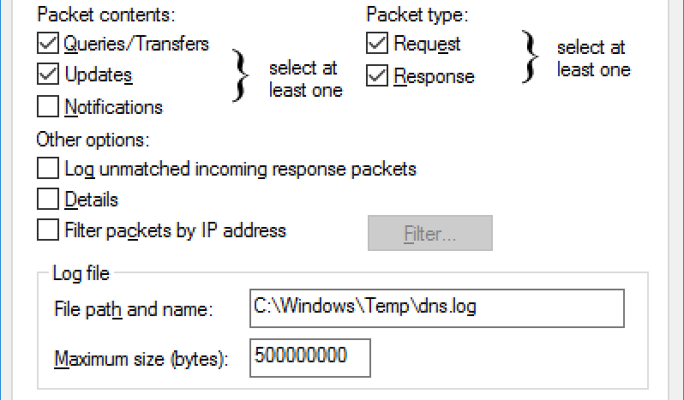
Where Can I Get What I Want?
DNS Server Logs
You’d be surprised how many web sites pull from Buckets directly through HTML, and how many Javascript libraries pull from Buckets after page load once the script runs.
Own your own DNS Relay? Turn logging on and process the data periodically. New Buckets can be queued and processed.

Slide 32
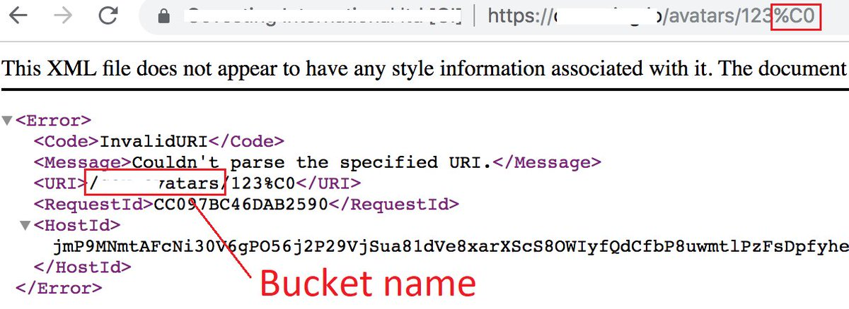
Where Can I Get What I Want?
The %C0 Trick (Credit to @0xmdv)
You find a Bucket addressable by https://website.com/path/to/file where /path/to/ is actually routed to a Bucket
Add %C0 to the end of the URL
The URI component of the XML error returned contains the Bucket name
Notes:
And finally…
Find the Region problem

Slide 33
Agenda
whoami?
What Do I Want and How Do I Get It?
Where Can I Get What I Want?
Where’s my Merciless Automation?
Any Results?
So What Do I Do?
What’s Next?
Questions?

Slide 34

Where’s my Merciless Automation?
Craal: https://github.com/jaylagorio/craal/
A Windows Service that crawls Pastebin and Github for everything we’ve talked about
Divides workflows up in different data processors that run on different threads
Backed by Microsoft SQL Server for data storage and coordination among the data processors

Slide 35
Where’s my Merciless Automation?
Craal: https://github.com/jaylagorio/craal/
Saves posts from Pastebin and commits from Github when they contain keywords of interest that you define.

Slide 36
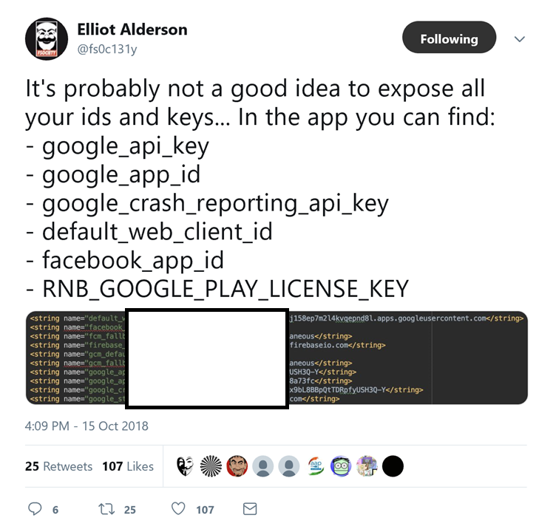

Slide 37
Where’s my Merciless Automation?
Craal: https://github.com/jaylagorio/craal/
Saves posts from Pastebin and commits from Github when they contain keywords of interest that you define.
Queues Amazon S3 Buckets for query when found from the Protoxin Bucket list as it gets updated, from CertStream in real-time, and from DNS Server logs when submitted.
Queues the Bucket for search, searches the Bucket for filenames and extensions of interest.
Saves interesting data to the database while tracking its origin.

Slide 38
Where’s my Merciless Automation?
Craal: https://github.com/jaylagorio/craal/
Has a frontend that runs on IIS for content indexing, search, and presentation
Page through results, explore things that look interesting, the rest roll off after a period of time to make room for new data
It’s more than a little rough

Slide 39
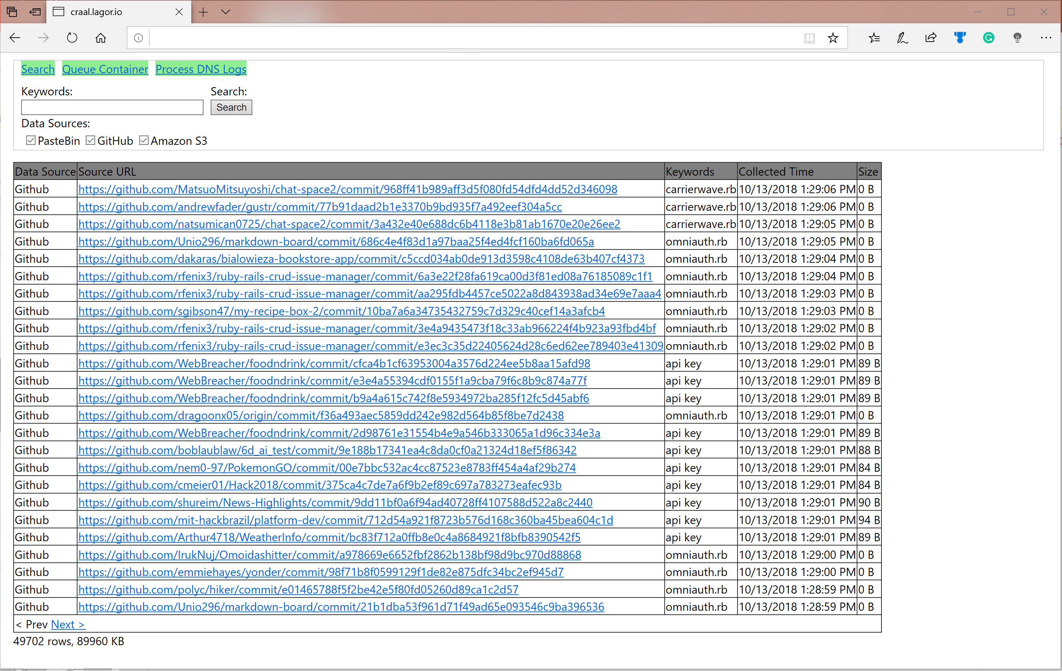

Slide 40
Where’s my Merciless Automation?
You can run this on a single system, but how can you scale if you want?
The SQL, Web, and Search Services can be separate as long as each system is pointed at its counterpart.
Scale Out
You can add as many Craal Search Service systems that you need.
One system only does Pastebin, one only does GitHub, several that do Bucket dumping, etc.
Point them all at your SQL Server.
Scale Up
SQL Server being the dumping ground for data, have ample storage on this system.
Or increase other resources depending on how many Craal Search Service systems you have.

Slide 41
Agenda
whoami?
What Do I Want and How Do I Get It?
Where Can I Get What I Want?
Where’s my Merciless Automation?
Any Results?
So What Do I Do?
What’s Next?
Questions?

Slide 42
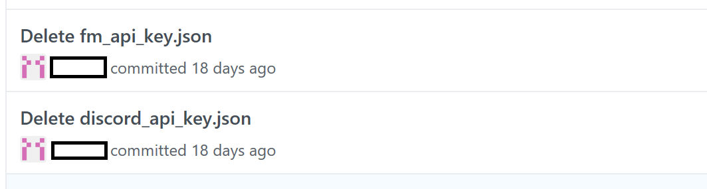
Any Results?
API Keys for days!
https://github.com/...df49934b8ac1da10/fm_api_key.json
https://github.com/...e1ac29703324509/discord_api_key.json
Naturally I checked the content and went to write the author a note to roll his creds.
When I looked at the repo, the files were gone. How did I find the files if they were deleted? What happened?
Git remembers everything, that’s what happened.

Slide 43
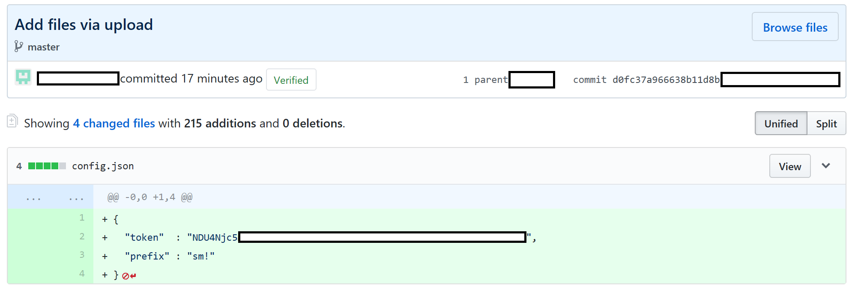
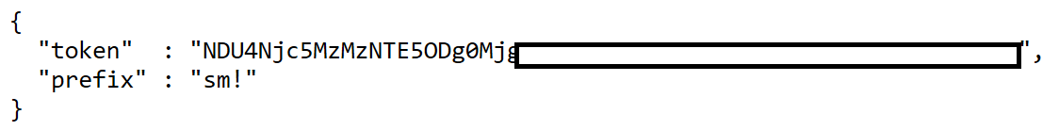
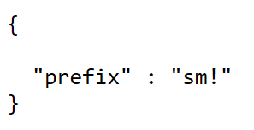
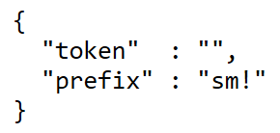
Any Results?
API Keys for days!
https://raw.githubusercontent.com/...cac5e01a0a27f/config.json
https://raw.githubusercontent.com/...a65300370ee7/config.json
https://raw.githubusercontent.com/...e8eabbd5e82b/config.json
Notes:
17 minutes, low time to compromise for those keys

Slide 44
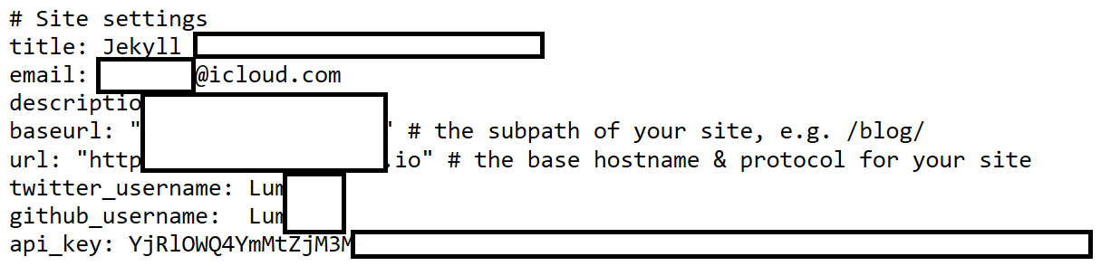
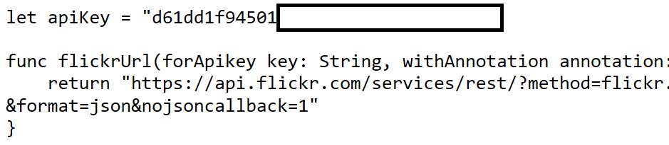
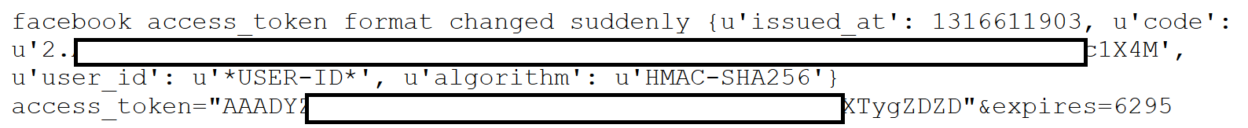
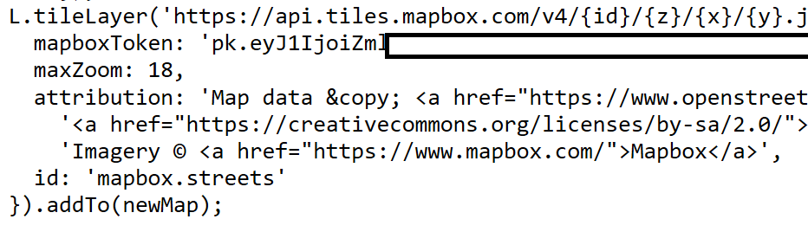
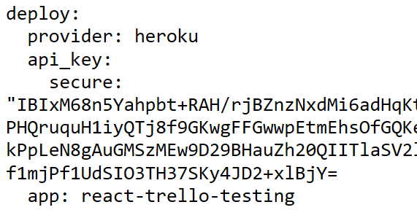
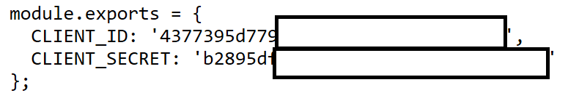
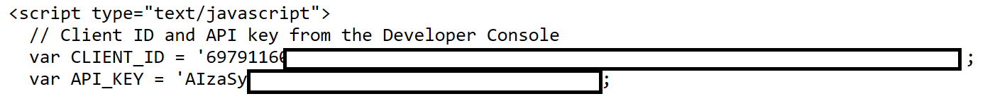
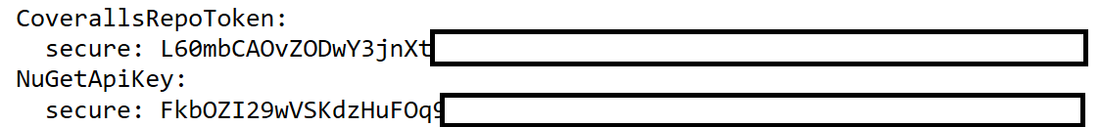
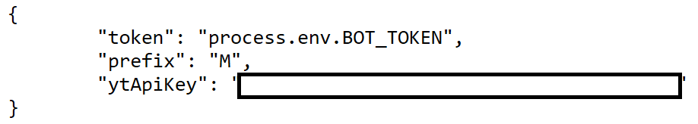
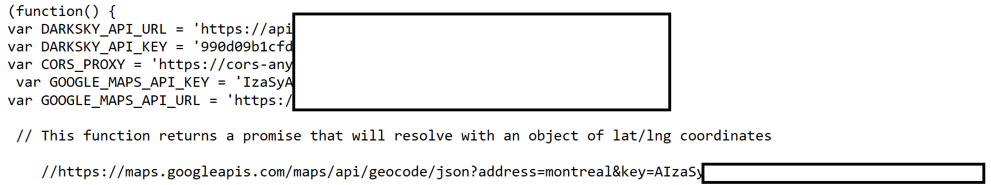
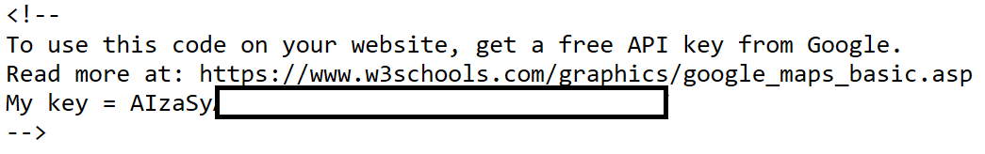
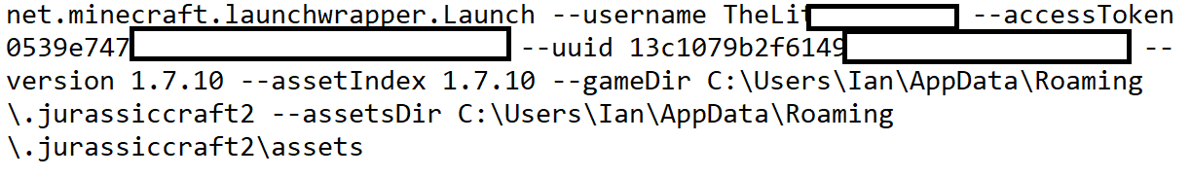
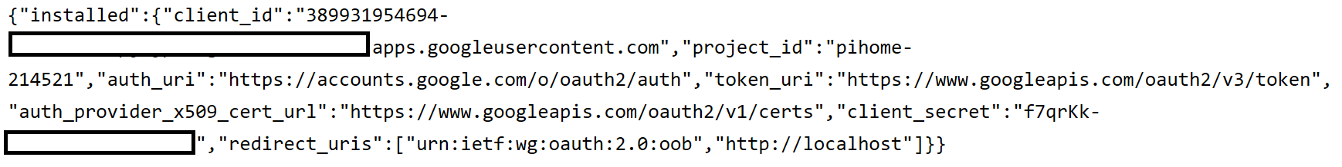
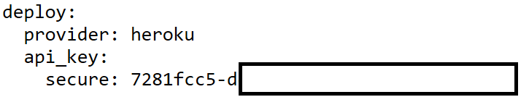
Any Results?
No, seriously, if you want keys to a service just go looking

Slide 45
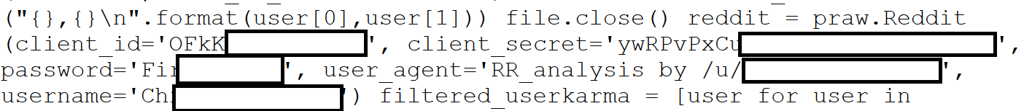
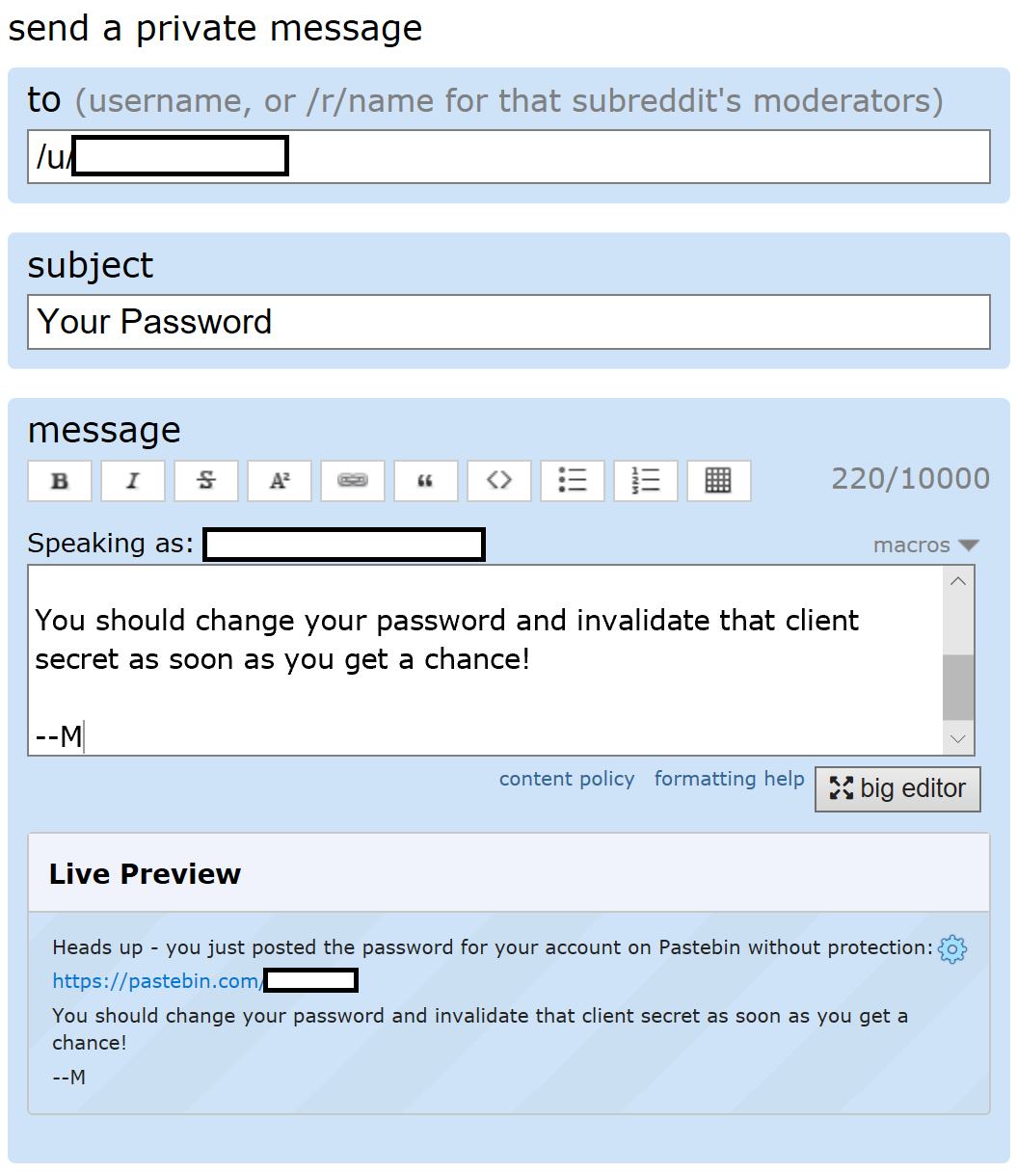
Any Results?

Slide 46
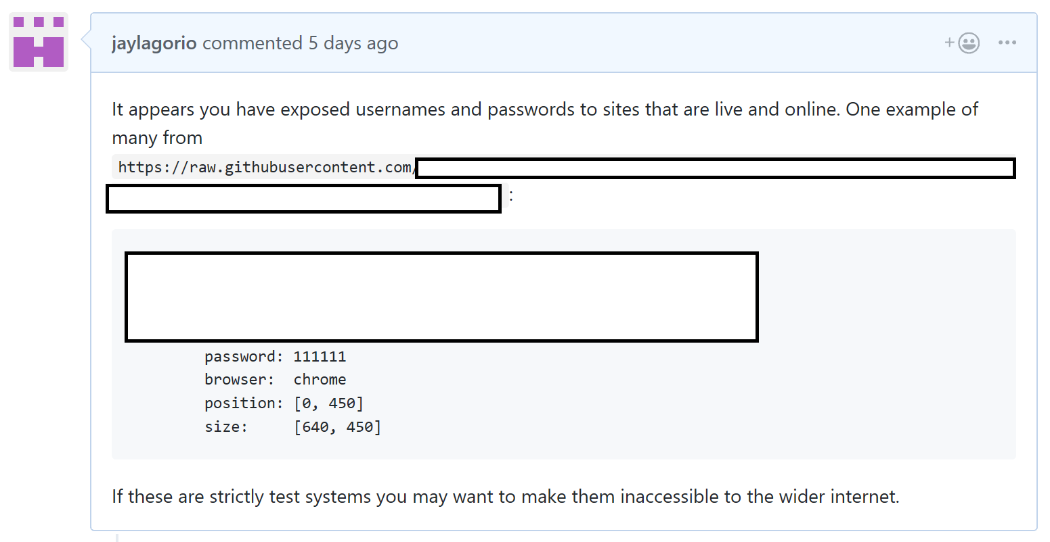
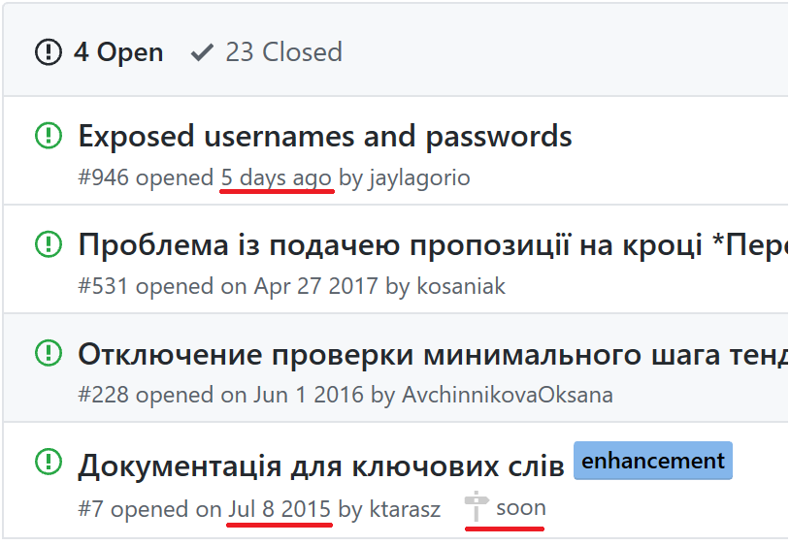
Any Results?

Slide 47

Any Results?

Slide 48
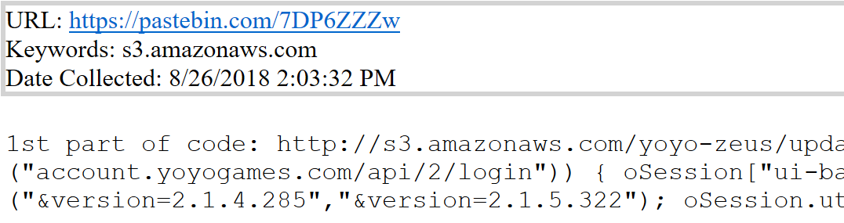
Any Results?
Buckets
M3U Playlists

Slide 49
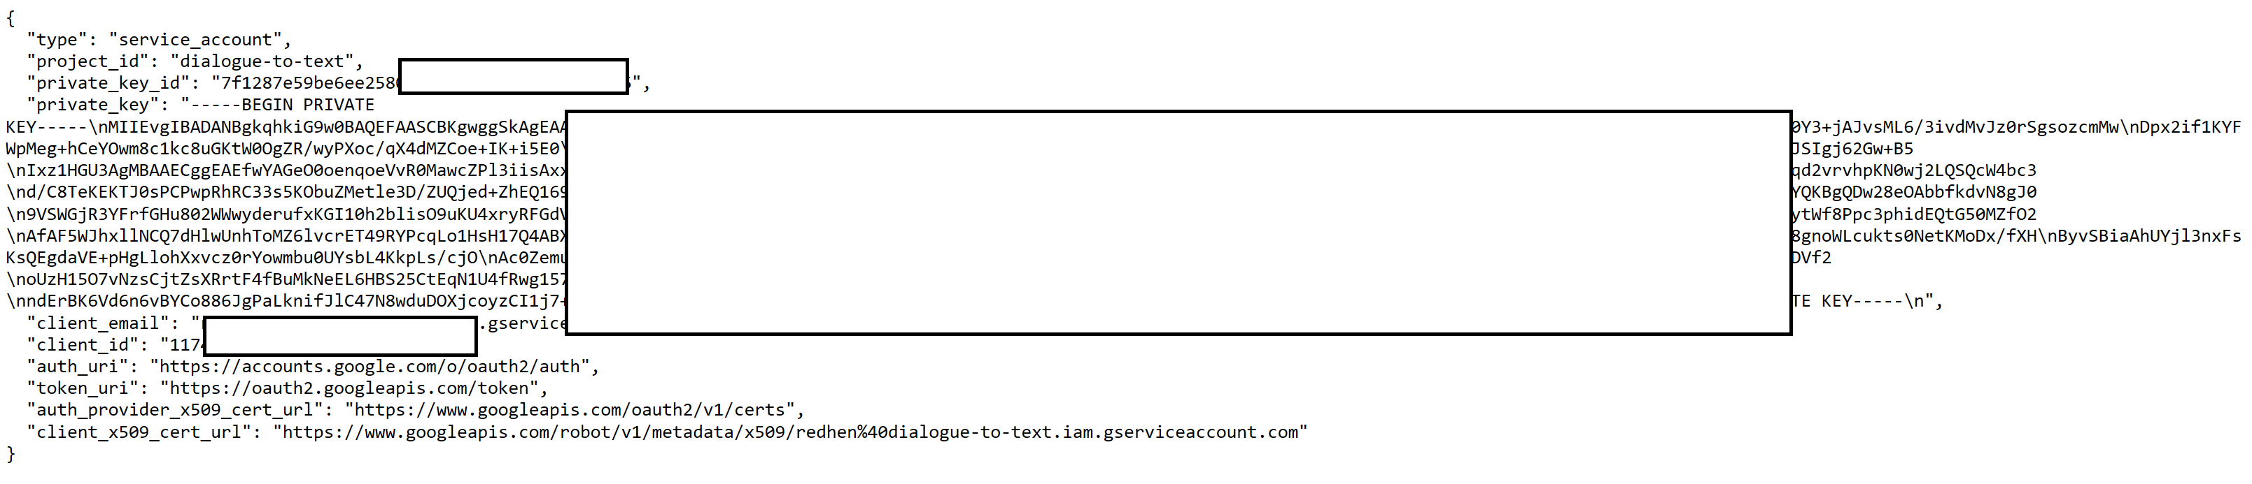
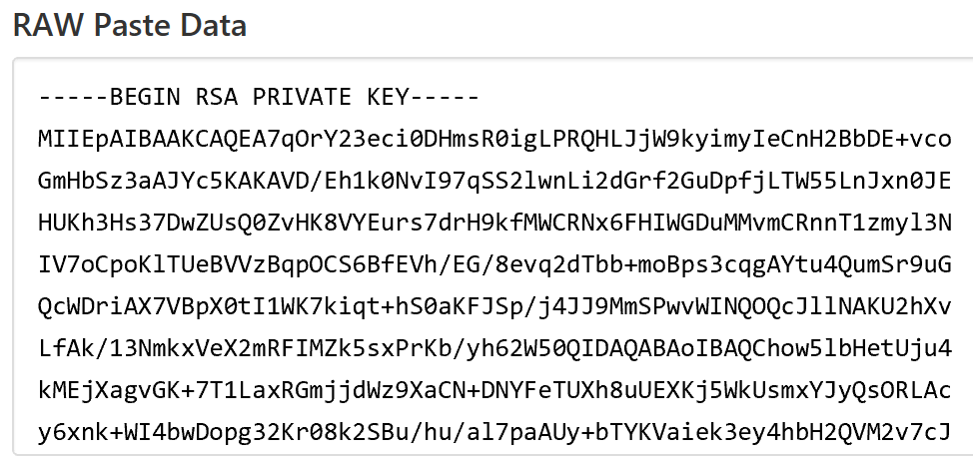
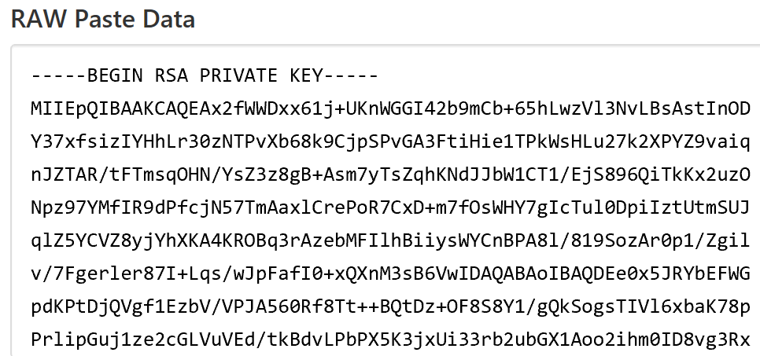
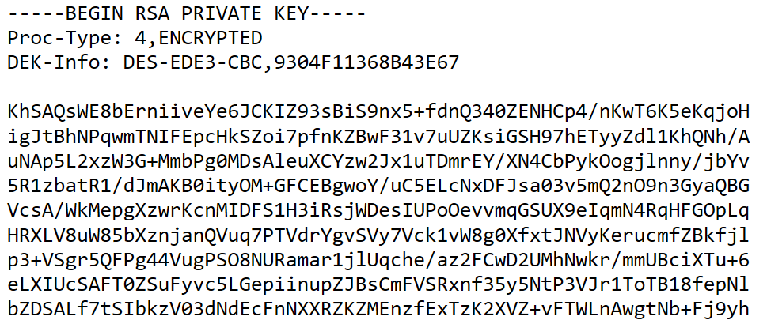
Any Results?
Too many private keys. So many private keys.
AWS creds to a Taiwanese social media service in the making – which had passports and user profile pictures in the Bucket.

Slide 50
Agenda
whoami?
What Do I Want and How Do I Get It?
Where Can I Get What I Want?
Where’s my Merciless Automation?
Any Results?
So What Do I Do?
What’s Next?
Questions?

Slide 51
So What Do I Do?
Be hypervigilant about what kind of material you add to your project if you plan on making it open source.
Don’t pull API keys or cryptographic material from files in your project, pull them from your environment variables or files in your environment that exist outside the project.
Bonus: Now you can easily use different keys and cryptographic material in test and production!
Don’t use Pastebin as group chat, and if you do make sure any logging statements you put in there don’t contain sensitive information.

Slide 52
So What Do I Do?
What if it’s too late and you’ve already committed something sensitive to your repository?
You can’t just delete the file and commit the modification, you have to completely remove the file from the repository’s history.
You are super boned if your project is more than just you. Get ready for a full on side quest of suck.
Stephen Ostermiller:
I couldn’t find much about him, so maybe he’s just a guy, but he figured out all the gymnastics you have to do to get something out of Git for good.
https://blog.ostermiller.org/git-remove-from-history

Slide 53
So What Do I Do?
How do you not open your Bucket to the world?

Slide 54

So What Do I Do?

Slide 55

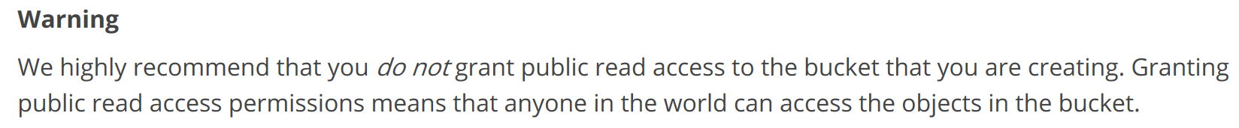
So What Do I Do?
How do you not open your Bucket to the world?
Don’t do a goddamned thing.

Slide 56
So What Do I Do?
How do you not open your Bucket to the world?
Protip: Don’t allow authenticated-read access to your Bucket.
AuthenticatedUsers isn’t just authentication tokens for your enterprise, of which there can be many. It is ANYONE with an AWS account.
What if your permissions are already too permitty?
Switch to private, bucket-owner-read, bucket-owner-full-control
Audit all your Buckets to make sure you follow principles of least privilege. Application A shouldn’t have access to Application B’s Bucket if it doesn’t need it.
Notes:
Explain Applications A, B, and C and Buckets A, B, and C
I know it sucks to have to do, but it’s not hard, I know you can do it

Slide 57
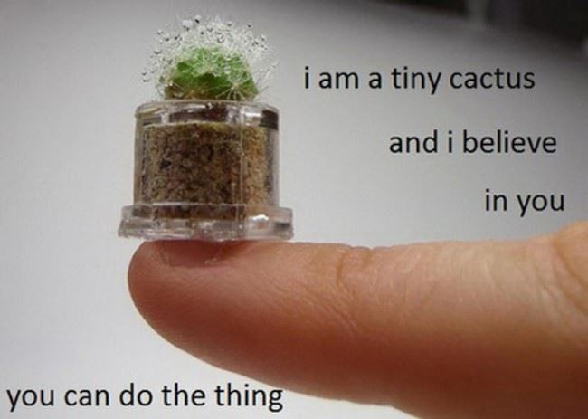

Slide 58
Agenda
whoami?
What Do I Want and How Do I Get It?
Where Can I Get What I Want?
Where’s my Merciless Automation?
Any Results?
So What Do I Do?
What’s Next?
Questions?

Slide 59
What’s Next?
Handle Bucket domains better
There are other FQDNs that you can use to detect Bucket names.
There are better ways to queue Buckets while retaining their different regions and have them queried from the proper region. This implementation is rough around the edges and assumes the US East region.
Azure and DigitalOcean Storage
The data structures and database schema are architected to handle Azure and DigitalOcean Storage blobs, but data processors haven’t been written for these services yet.
A Frontend that isn’t trash garbage
Top of the list of frontend devs who are way better than me: Drunk toddlers
File types that can be displayed in a useful way via the web frontend

Slide 60
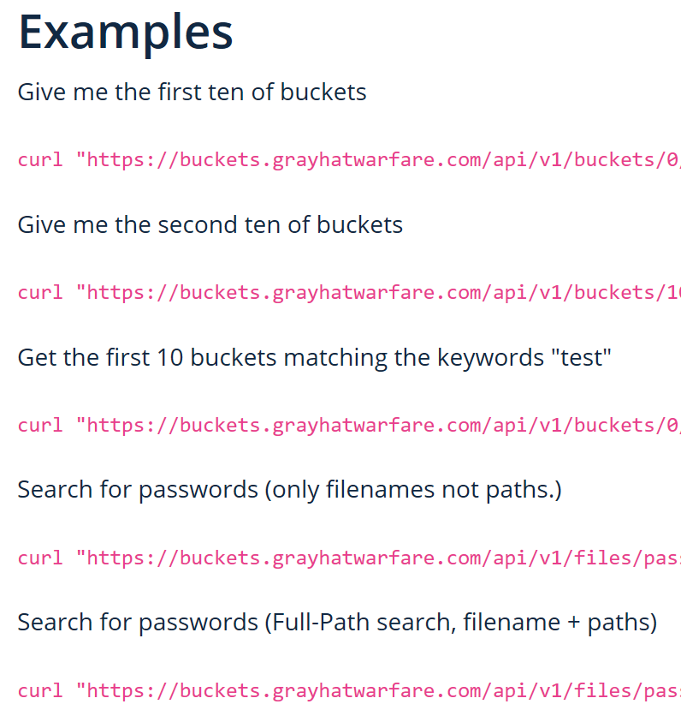
What’s Next?
Greyhatwarfare Integration
Kind of like the Protoxin List, but bigger and offers a subscription
Free account with limits, or €20/mo
Offers an easy to use API
You can scrape the Buckets into your database of Buckets, or scrape files they’ve scraped to see if there’s anything interesting
Or both!

Slide 61
What’s Next?
Integrations
Trufflehog
Git-all-secrets
Scanning for entropy
Pull requests welcome

Slide 62
Acknowledgements
Protoxin (https://protoxin.net)
CertStream (https://certstream.calidog.io/)
Daniel Matviyiv (@0xmdv)
UpGuard (https://www.upguard.com/)
Kromtech Security Center (https://kromtech.com/)
Chris Vickery (@VickerySec)
Stephen Ostermiller (https://ostermiller.org/)

Slide 63
Agenda
whoami?
What Do I Want and How Do I Get It?
Where Can I Get What I Want?
Where’s my Merciless Automation?
Any Results?
So What Do I Do?
What’s Next?
Questions?

Slide 64

Questions?
Web: https://lagor.io
Email: jay@lagor.io
Twitter: @jaylagorio
Github: @jaylagorio

